Slide 1
Activity Log
By:
Praneeth Paruchuri
Mounika karampudi
Divya Sree Vintha
Sivaji Ganesh Kandimalla

Slide 2
Introduction
In this modernized world, fitness plays an important role in our daily lives.
A smart phone application which shows how active a person is throughout the day.
addiction of smart phones which can be controlled and used to maintain the daily fitness activities.
We have created a mobile cloud application on Bluemix.

Slide 3
IDEA..
Daily activeness of a person can be measured using smartphone movements based on the accelerometer readings of the smart phone.
Activeness is calculated using the difference in the x,y,z values and the time for the change and a graph is plotted based on these readings.

Slide 4
Users can analyze their physical work based on the points and the graph plotted.
This can be used in analyzing user’s idle time and work time.

Slide 5
Working Model
More the phone movement, more the points you gain.
The accelerometer readings i.e,X,Y,Z values are collected from the phone movements.
A threshold value is set and if the readings reach the threshold value, points are gained else no points are awarded.

Slide 6
Timer...
We also have a timer which updates the data every hour automatically to the Cloud.

Slide 7
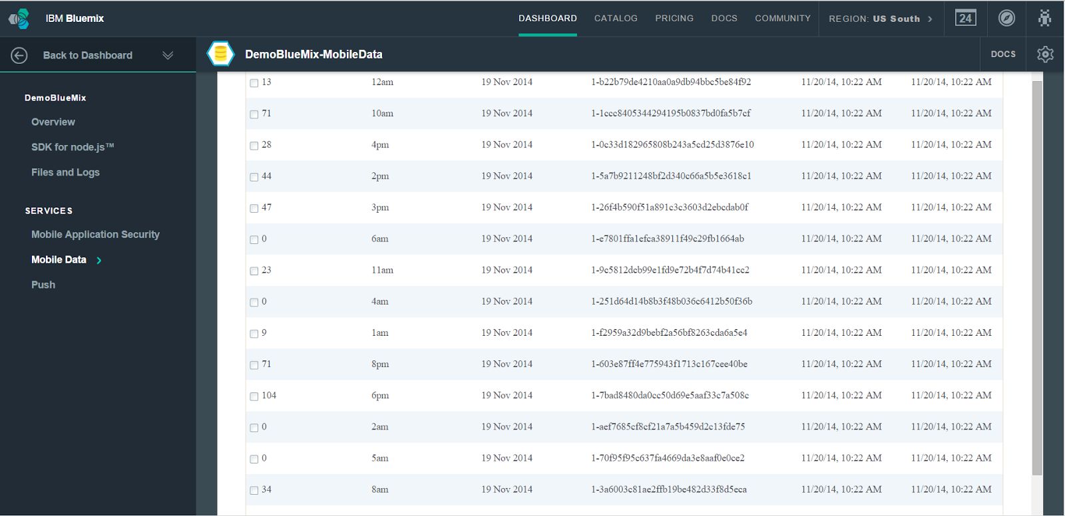

Slide 8
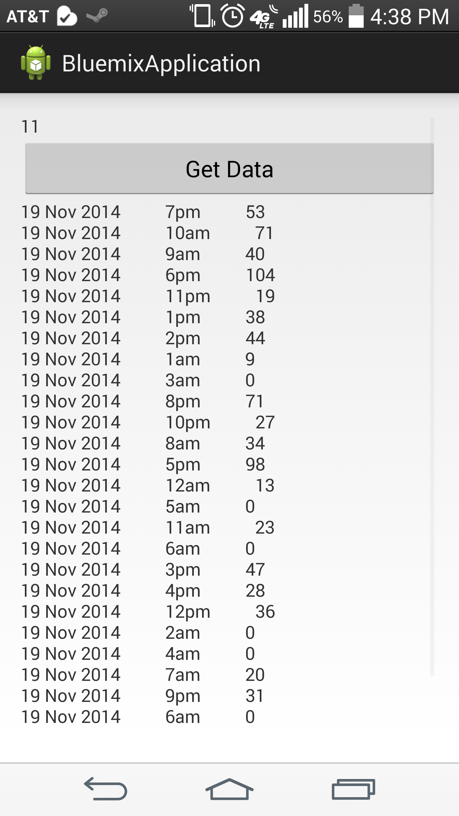

Slide 9
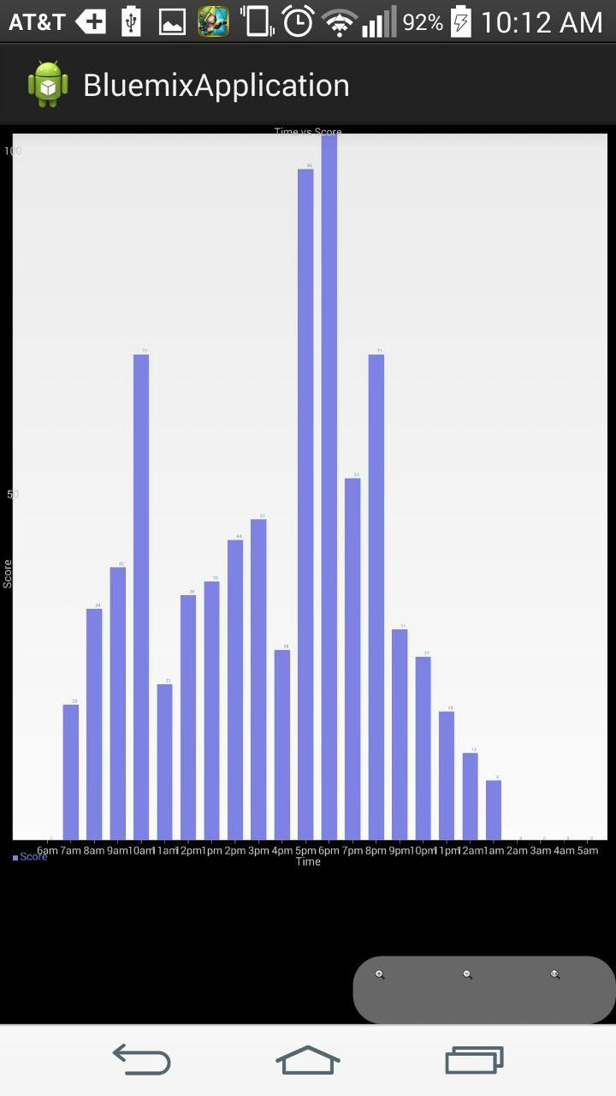
Bar Graph View

Slide 10
Limitations/Future Work
This application doesn’t run as a background service yet, so collecting data right now for every hour is not possible. We had to use dummy data to show the working of the application.
Once the application is closed and reopened the timer would’ve stopped and started again, so the app has to be running continuously for at least an hour to push an update to the cloud.
The UI can see a lot of improvement.

Slide 11
References
https://www.ibm.com/developerworks/library/mo-android-mobiledata-app/#N1021F
http://wptrafficanalyzer.in/blog/android-drawing-bar-chart-using-achartengine/
https://code.google.com/p/achartengine/downloads/list

Slide 12
Thank You!

